Slide 1
Analysis Based Imbalanced Learning Framework
Tianfu He
Tianfu.He@qq.com
Harbin Institute of Technology

Slide 2
Imbalanced Data
The data distribution is imbalanced between classes.
Imbalanced data is getting much attention.
Clinic Analysis
Fraud Detection
Why problem comes?
Traditional models for classification are designed assuming the data is balanced.
We call this Imbalanced Data Set(IDS) problem.

Slide 3


Imbalanced Data vs. IDS Problem
Two imbalanced datasets, Letter and Pima from UCI machine learning repository, run on sklearn.svm.SVC with default settings.
Why? There must be something beyond imbalanced rate.
IDS is like imperfect cube, but suffers from different problems caused by imbalance.
 | As negative | As positive
Is negative | 19211 | 0
Is positive | 83 | 706
F-1 Score | 0.94
 | As negative | As positive
Is negative | 438 | 62
Is positive | 114 | 154
F-1 Score | 0.64
Letter, imbalanced rate $24.3:1$
Pima, imbalanced rate $1.87:1$
Lichman, M. (2013). UCI Machine Learning Repository [http://archive.ics.uci.edu/ml]. Irvine, CA: University of California, School of Information and Computer Science.

Slide 4
Outline
Motivation and Our Framework
How IDS impacts on learning
Existing Kinds of Imbalanced Learning Techniques
Proposal: A Strategy to select technique
Experiments to verify proposal

Slide 5
Motivation
Proposal: we can find appropriate solutions for a given dataset!
A
B
A
A
B
B
B
C
C
Different kinds of solutions
IDS suffers from different problems

Slide 6
Motivation
Proposal: we can find appropriate solutions for a given dataset!
A
A
A
B
B
B
B
C
C
Different kinds of solutions
IDS suffers from different problems

Slide 7
Motivation
Proposal: we can find appropriate solutions for a given dataset!
A
A
A
B
B
B
B
C
C
Different kinds of solutions
IDS suffers from different problems

Slide 8
Key to the solution
Make sure existing imbalanced learning techniques are designed to solve certain problem of an IDS.
A method to observe the problem in the given IDS, where the problems are just corresponding to what existing solutions can solve.
A
?
?
B
A
?
?
A
B
?
B
?
?
B
C
C

Slide 9


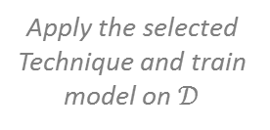

Key to the solution
Analysis Based Imbalanced Learning Framework (ABILF)
Make sure existing imbalanced learning techniques are designed to solve certain problem of an IDS.
A method to observe the problem in the given IDS, where the problems are just corresponding to what existing solutions can solve.
?
?
B
A
IDS Analysis Module
Tech. Selection Module
?
?
A
B
?
?
B
C
Featured IDS $𝒟$
$𝒟$ with $imAttr\left(𝒟\right)$
Get Imbalance Attribute $imAttr\left(𝒟\right)$
Existing Techniques for IDS
Training
Module
Working on
Summarized Conclusions,
or Expert Experience
Trained
Model
A
Appropriate Technique
Apply the selected Technique and train model on $𝒟$
?
B
C

Slide 10
Outline
Motivation and Our Framework
How IDS impacts on learning
Existing Kinds of Imbalanced Learning Techniques
Proposal: A Strategy to select technique
Experiments to verify proposal

Slide 11
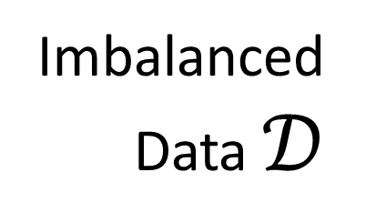
How IDS impacts on learning
Analysis Based Imbalanced Learning Framework (ABILF)
Extremely Imbalance
Overlap between classes
Intrinsic difficulty of learning, e.g. dirty data
Suffer from small disjuncts
Imbalanced Data $𝒟$
IDS Analysis Module
Tech. Selection Module
Featured IDS $𝒟$
$𝒟$ with $imAttr\left(𝒟\right)$
Get Imbalance Attribute $imAttr\left(𝒟\right)$
Existing Techniques for IDS
Training
Module
Working on
Summarized Conclusions,
or Expert Experience
Trained
Model
Appropriate Technique
Apply the selected Technique and train model on $𝒟$

Slide 12
How IDS impacts on learning
Analysis Based Imbalanced Learning Framework (ABILF)
Extremely Imbalance
Overlap between classes
Intrinsic difficulty of learning, e.g. dirty data
Suffer from small disjuncts
Imbalanced Data $𝒟$
IDS Analysis Module
Tech. Selection Module
Featured IDS $𝒟$
$𝒟$ with $imAttr\left(𝒟\right)$
Get Imbalance Attribute $imAttr\left(𝒟\right)$
Existing Techniques for IDS
Training
Module
Working on
Summarized Conclusions,
or Expert Experience
Trained
Model
Appropriate Technique
Apply the selected Technique and train model on $𝒟$

Slide 13
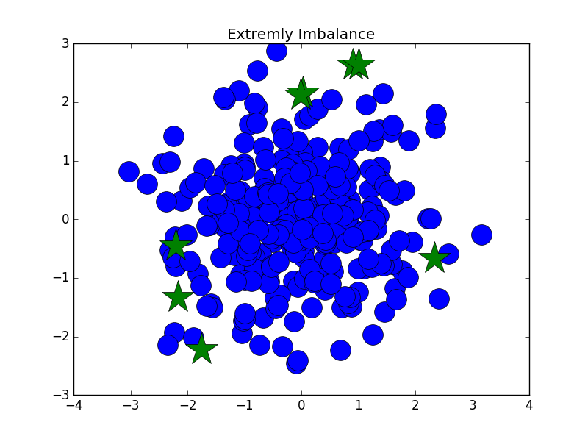
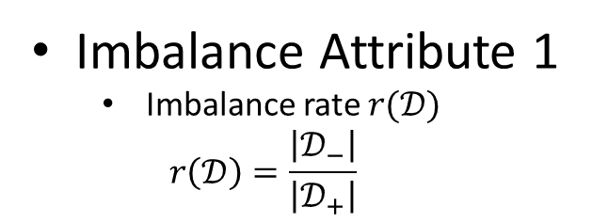
How IDS impacts on learning
Extremely Imbalance
Overlap between classes
Intrinsic difficulty of learning, e.g. dirty data
Suffer from small disjuncts
Imbalance Attribute 1
Imbalance rate $r(𝒟)$
$$r\left(𝒟\right)=\frac{\left|𝒟_{−}\right|}{\left|𝒟_{+}\right|}$$
Problems are MAGNIFIED when it comes to Imbalanced data!
Notes:
Overlook

Slide 14
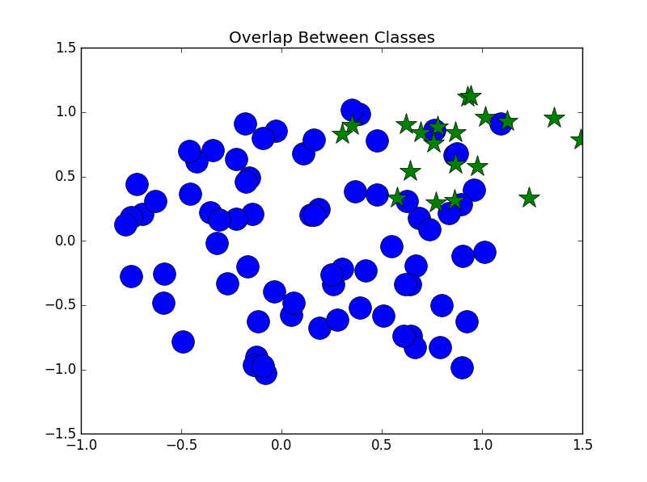
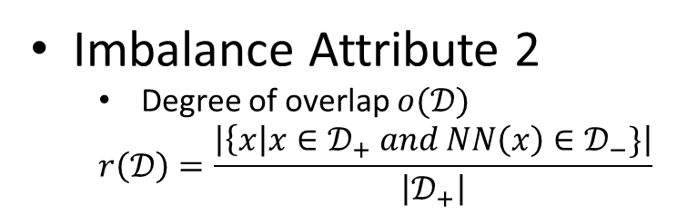
How IDS impacts on learning
Extremely Imbalance
Overlap between classes
Intrinsic difficulty of learning, e.g. dirty data
Suffer from small disjuncts
Imbalance Attribute 2
Degree of overlap $o(𝒟)$
$$r\left(𝒟\right)=\frac{\left|\left\{x\right|x∈𝒟_{+} and NN\left(x\right)∈𝒟_{−}\}\right|}{\left|𝒟_{+}\right|}$$
Problems are MAGNIFIED when it comes to Imbalanced data!
Notes:
Little noise from positive

Slide 15
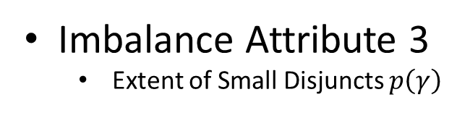
How IDS impacts on learning
Extremely Imbalance
Overlap between classes
Intrinsic difficulty of learning, e.g. dirty data
Suffer from small disjuncts
Learned
Boundary
True
Boundary
Imbalance Attribute 3
Extent of Small Disjuncts $p\left(γ\right)$
Problems are MAGNIFIED when it comes to Imbalanced data!

Slide 16
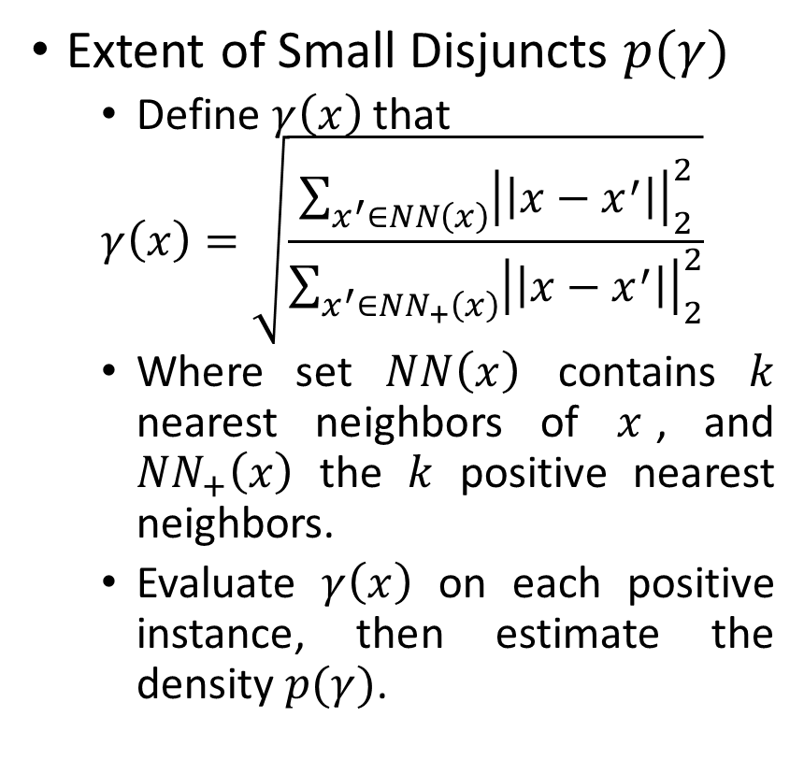

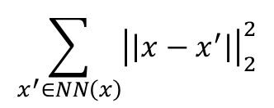
Imbalance Attribute 3
Extent of Small Disjuncts $p(γ)$
Define $γ\left(x\right)$ that
$$γ\left(x\right)=\sqrt{\frac{\sum_{x^{′}∈NN\left(x\right)}{{\left|\left|x−x^{′}\right|\right|}_{2}^{2}}}{\sum_{x^{′}∈NN_{+}\left(x\right)}{{\left|\left|x−x^{′}\right|\right|}_{2}^{2}}}}$$
Where set $NN\left(x\right)$ contains $k$ nearest neighbors of $x$, and $NN_{+}\left(x\right)$ the $k$ positive nearest neighbors.
Evaluate $γ\left(x\right)$ on each positive instance, then estimate the density $p(γ)$.
$$\sum_{x^{′}∈NN\left(x\right)}{{\left|\left|x−x^{′}\right|\right|}_{2}^{2}}$$
$$\sum_{x^{′}∈NN_{+}\left(x\right)}{{\left|\left|x−x^{′}\right|\right|}_{2}^{2}}$$

Slide 17

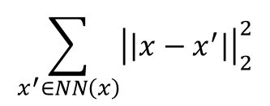

$$\sum_{x^{′}∈NN\left(x\right)}{{\left|\left|x−x^{′}\right|\right|}_{2}^{2}}$$
$$\sum_{x^{′}∈NN_{+}\left(x\right)}{{\left|\left|x−x^{′}\right|\right|}_{2}^{2}}$$
$$k=5,m=2$$

Slide 18
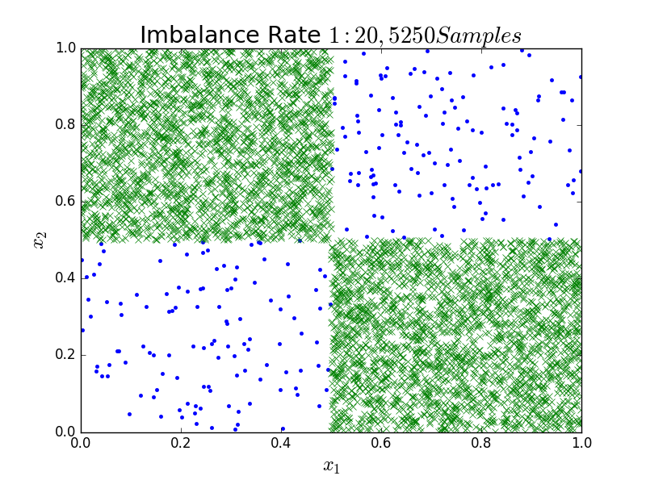
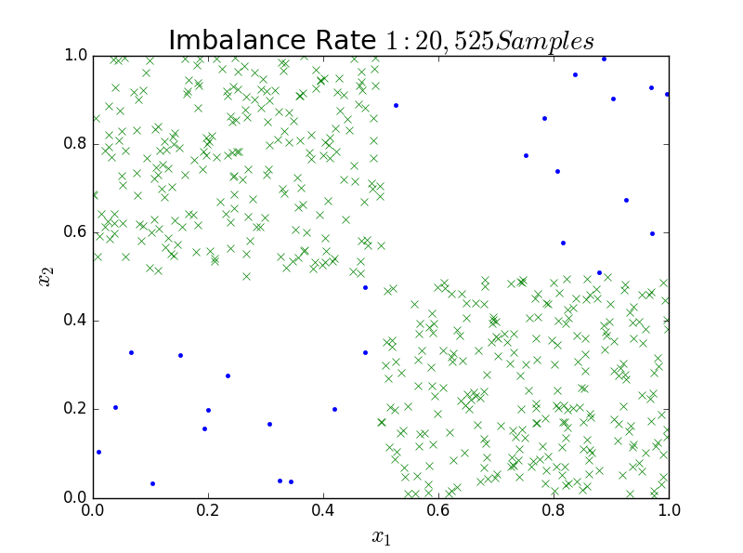
(a)
(b)

Slide 19
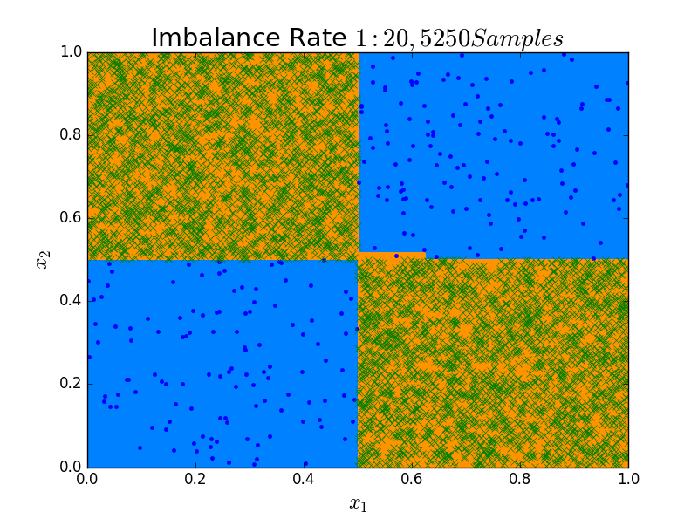
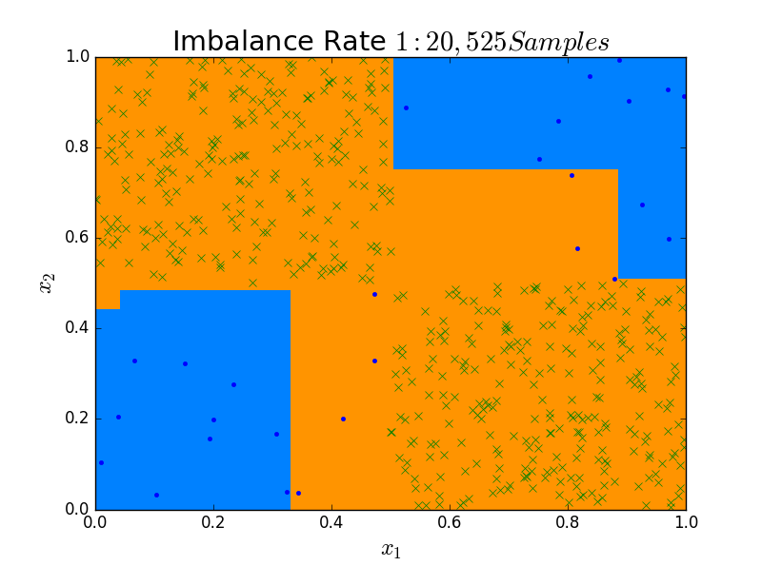
(a)
(b)

Slide 20
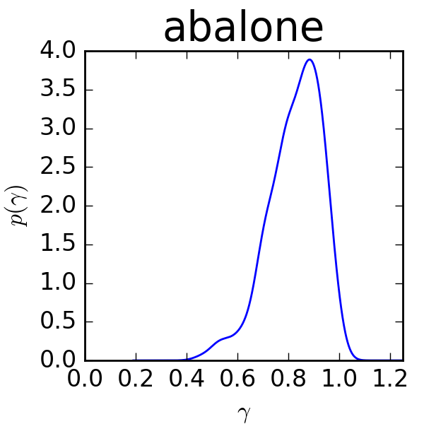
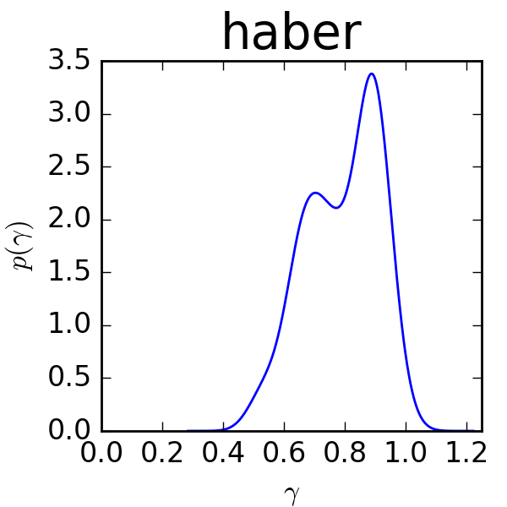
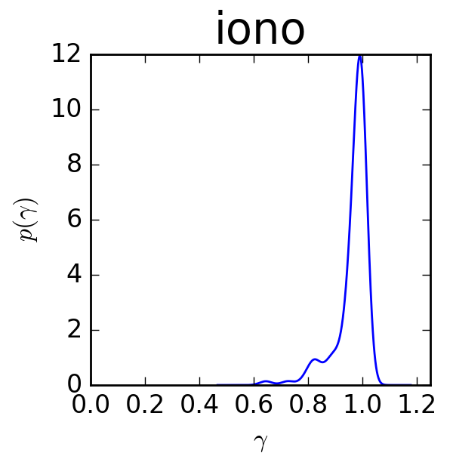
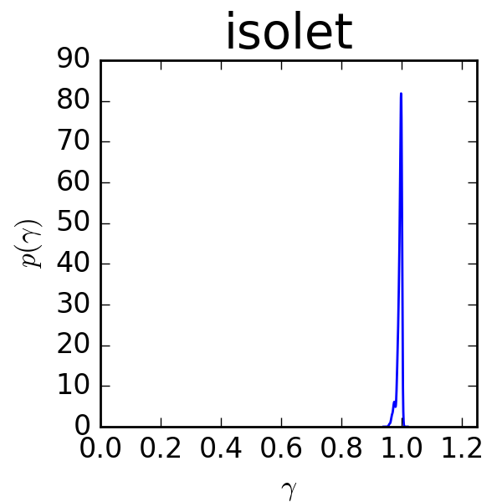
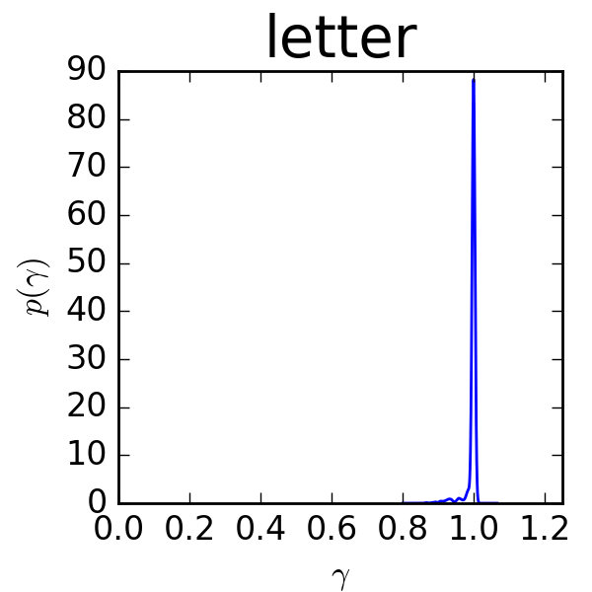
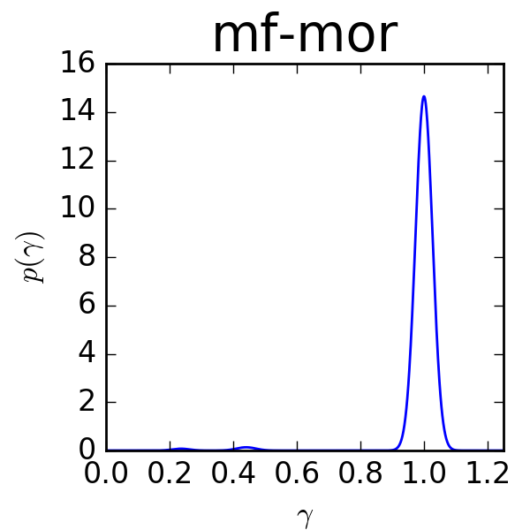
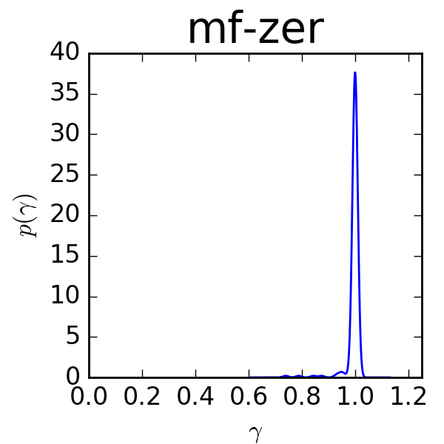
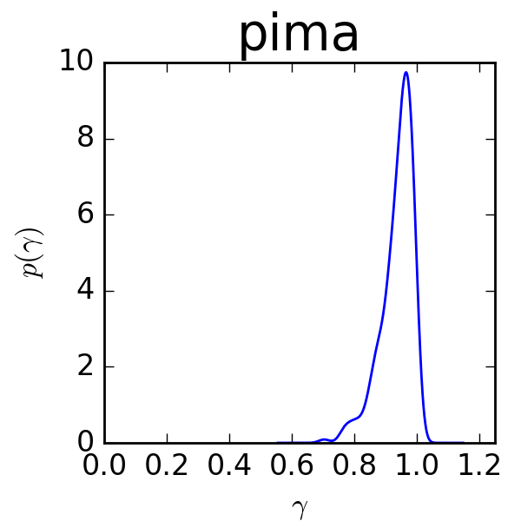
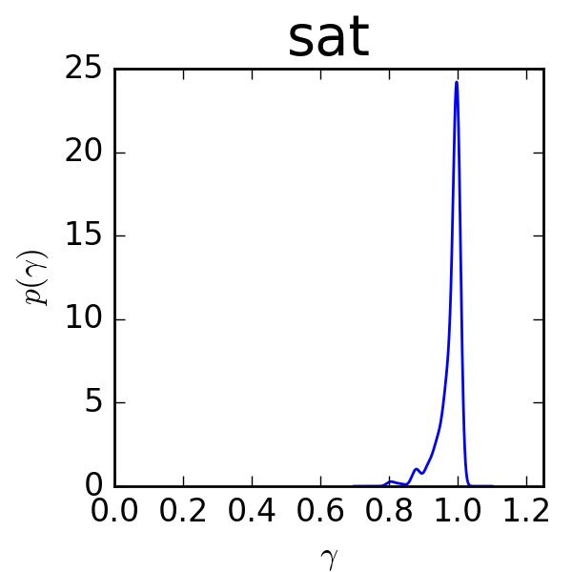
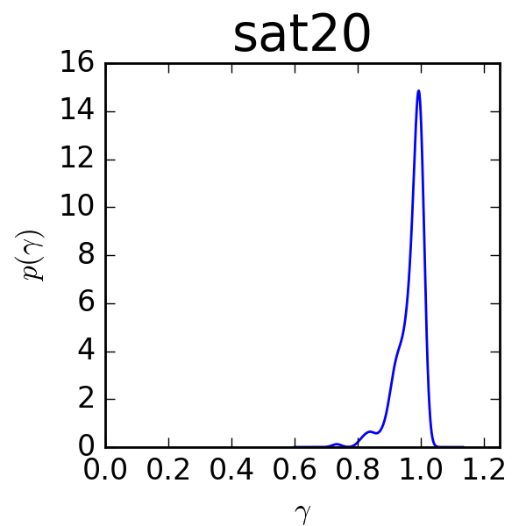
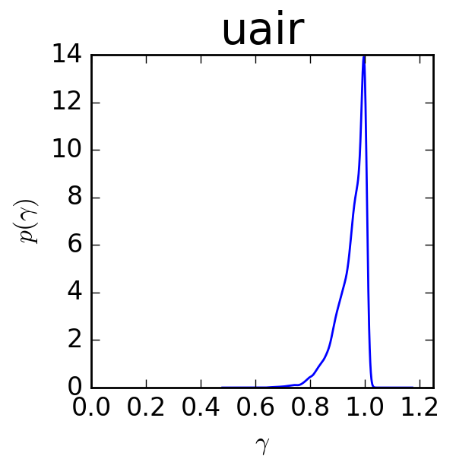

Slide 21
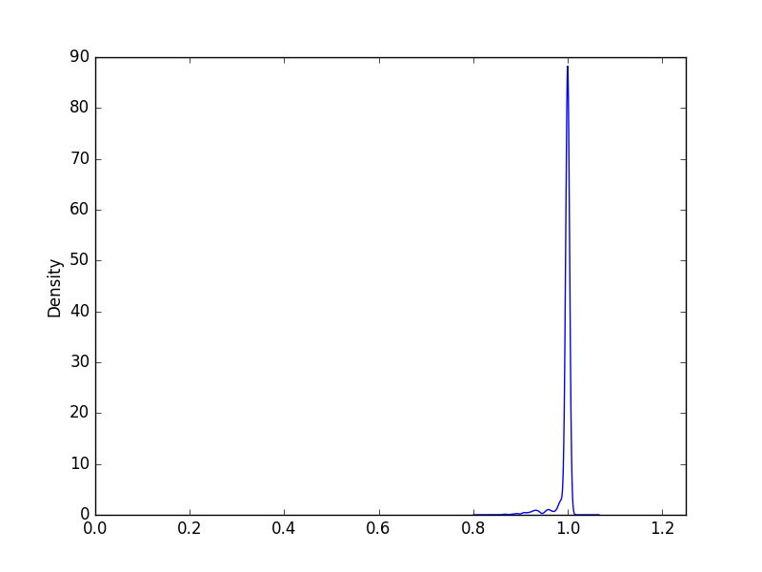
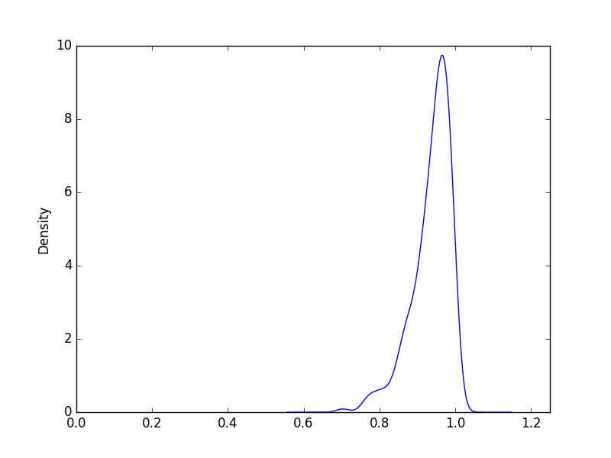
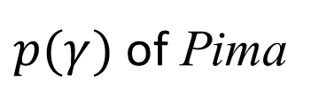
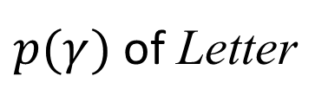
Imbalance Attribute 3
Extent of Small Disjuncts $p(γ)$
Define $γ\left(x\right)$ that
$$γ\left(x\right)=\sqrt{\frac{\sum_{x^{′}∈NN\left(x\right)}{{\left|\left|x−x^{′}\right|\right|}_{2}^{2}}}{\sum_{x^{′}∈NN_{+}\left(x\right)}{{\left|\left|x−x^{′}\right|\right|}_{2}^{2}}}}$$
Where set $NN\left(x\right)$ contains $k$ nearest neighbors of $x$, and $NN_{+}\left(x\right)$ the $k$ positive nearest neighbors.
Evaluate $γ\left(x\right)$ on each positive instance, then estimate the density $p(γ)$.
$p(γ)$ of Letter
$p(γ)$ of Pima

Slide 22
Outline
Motivation and Our Framework
How IDS impacts on learning
Existing Kinds of Imbalanced Learning Techniques
Proposal: A Strategy to select technique
Experiments to verify proposal

Slide 23

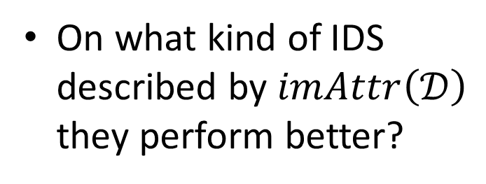
Analysis Based Imbalanced Learning Framework (ABILF)
IDS Analysis Module
$$<r\left(𝒟\right),o\left(𝒟\right),p\left(γ\right)>$$
Tech. Selection Module
Featured IDS $𝒟$
$𝒟$ with $imAttr\left(𝒟\right)$
Get Imbalance Attribute $imAttr\left(𝒟\right)$
Existing Techniques for IDS
Selecting Strategy
Training
Module
Working on
Summarized Conclusions,
or Expert Experience
Trained
Model
Appropriate Technique
Apply the selected Technique and train model on $𝒟$
On what kind of IDS described by $imAttr\left(𝒟\right)$ they perform better?

Slide 24
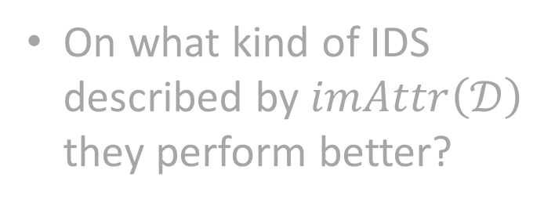
Existing Kinds of Imbalanced Learning Techniques
Analysis Based Imbalanced Learning Framework (ABILF)
Sampling Techniques
One Class Learning
Ensemble learning
IDS Analysis Module
$$<r\left(𝒟\right),o\left(𝒟\right),p\left(γ\right)>$$
Tech. Selection Module
Featured IDS $𝒟$
$𝒟$ with $imAttr\left(𝒟\right)$
Get Imbalance Attribute $imAttr\left(𝒟\right)$
Existing Techniques for IDS
Selecting Strategy
Training
Module
Working on
Summarized Conclusions,
or Expert Experience
Trained
Model
Appropriate Technique
Apply the selected Technique and train model on $𝒟$
On what kind of IDS described by $imAttr\left(𝒟\right)$ they perform better?

Slide 25
Existing Kinds of Imbalanced Learning Techniques
SMOTE
Very popular, insensitive to small disjuncts.
Algorithm as demonstrated.
How it works? SMOTE fills up empty space between positive instances therefore more representative.
MWMOTE
Similar to SMOTE, but sensitive to noises and small disjuncts.

Slide 26
One Class Learning
SVDD
Commonly used
Designed to grasp one class, which is in truth a hyper sphere boundary to cover the training data.
The object needs to be well represented by training data
Using SVDD in SimpleMKL for 3D-Shapes Filtering [http://gaelle.loosli.fr/using-svdd-in-simplemkl-for-3d-shapes-filtering/] by Gaëlle Loosli and Hattoibe Aboubacar.

Slide 27
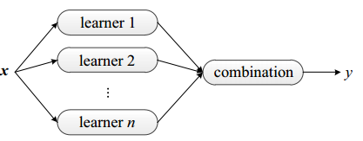
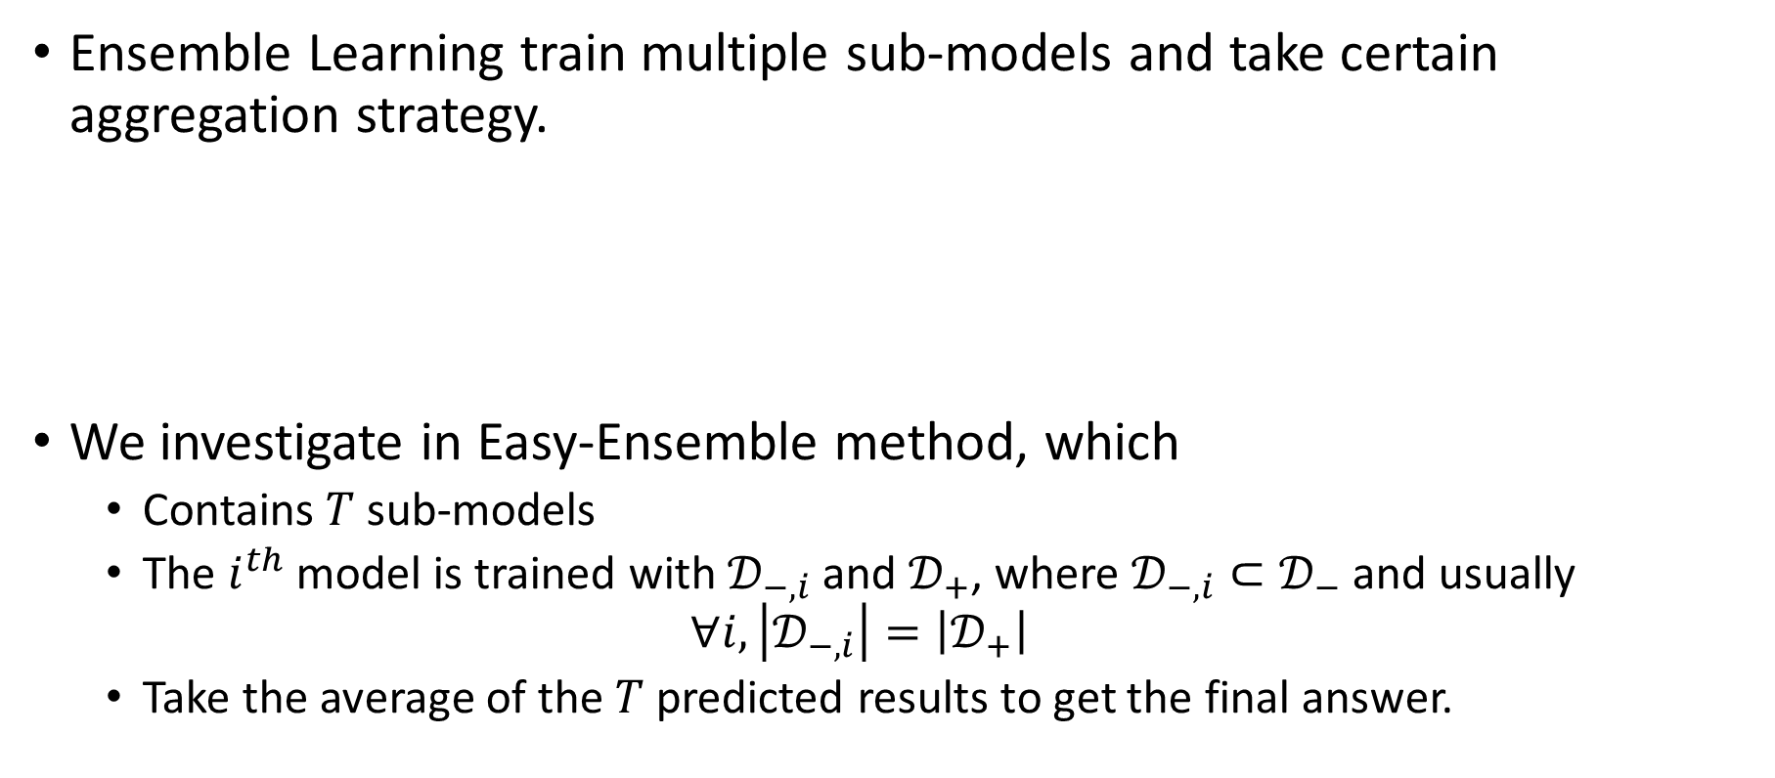
Ensemble Learning for IDS
Ensemble Learning train multiple sub-models and take certain aggregation strategy.
We investigate in Easy-Ensemble method, which
Contains $T$ sub-models
The $i^{th}$ model is trained with $𝒟_{−,i}$ and $𝒟_{+}$, where $𝒟_{−,i}⊂𝒟_{−}$ and usually
$$∀i, \left|𝒟_{−,i}\right|=\left|𝒟_{+}\right|$$
Take the average of the $T$ predicted results to get the final answer.

Slide 28
Existing Kinds of Imbalanced Learning Techniques
Analysis Based Imbalanced Learning Framework (ABILF)
Sampling Techniques
One Class Learning
Ensemble learning
IDS Analysis Module
$$<r\left(𝒟\right),o\left(𝒟\right),p\left(γ\right)>$$
Tech. Selection Module
Featured IDS $𝒟$
$𝒟$ with $imAttr\left(𝒟\right)$
Get Imbalance Attribute $imAttr\left(𝒟\right)$
Existing Techniques for IDS
Selecting Strategy
Training
Module
Working on
Summarized Conclusions,
or Expert Experience
Trained
Model
Appropriate Technique
Apply the selected Technique and train model on $𝒟$
On what kind of IDS described by $imAttr\left(𝒟\right)$ they perform better?

Slide 29
Outline
Motivation and Our Framework
How IDS impacts on learning
Existing Kinds of Imbalanced Learning Techniques
Proposal: A Strategy to select technique
Experiments to verify proposal

Slide 30
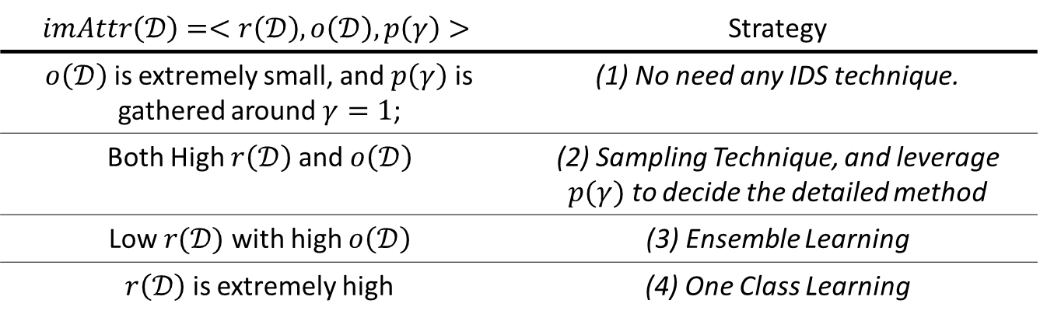

Selecting Strategy
Our conclusion covers four kinds of IDS with their $imAttr\left(𝒟\right)=<r\left(𝒟\right),o\left(𝒟\right),p\left(γ\right)>$ that we can directly choose the appropriate kind of technique.
$$imAttr\left(𝒟\right)=<r\left(𝒟\right),o\left(𝒟\right),p\left(γ\right)>$$ | Strategy
$o\left(𝒟\right)$ is extremely small, and $p\left(γ\right)$ is gathered around $γ=1$; | (1) No need any IDS technique.
Both High $r\left(𝒟\right)$ and $o\left(𝒟\right)$ | (2) Sampling Technique, and leverage $p(γ)$ to decide the detailed method
Low $r(𝒟)$ with high $o\left(𝒟\right)$ | (3) Ensemble Learning
$r\left(𝒟\right)$ is extremely high | (4) One Class Learning

Slide 31
Outline
Motivation and Our Framework
How IDS impacts on learning
Existing Kinds of Imbalanced Learning Techniques
Proposal: A Strategy to select technique
Experiments to verify proposal

Slide 32
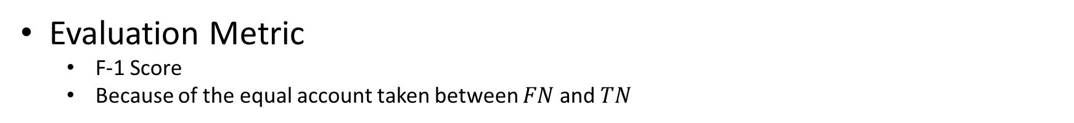
Experiments to verify proposal
Dataset
U-AIR contains PM2.5 records of 35 AQI stations in Beijing from 2014/05 to 2015/07, as well as spatial and temporal features extracted.
Evaluation Metric
F-1 Score
Because of the equal account taken between $FN$ and $TN$

Slide 33
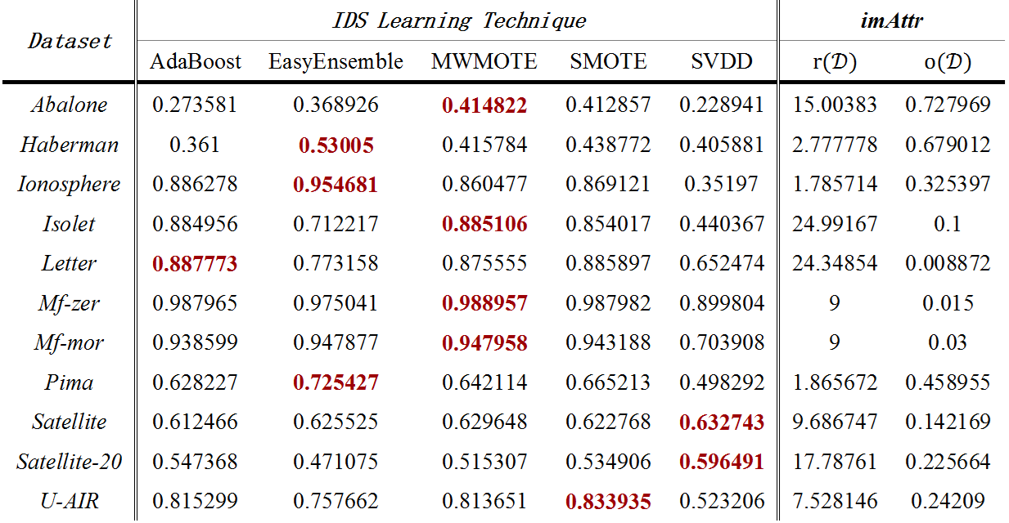
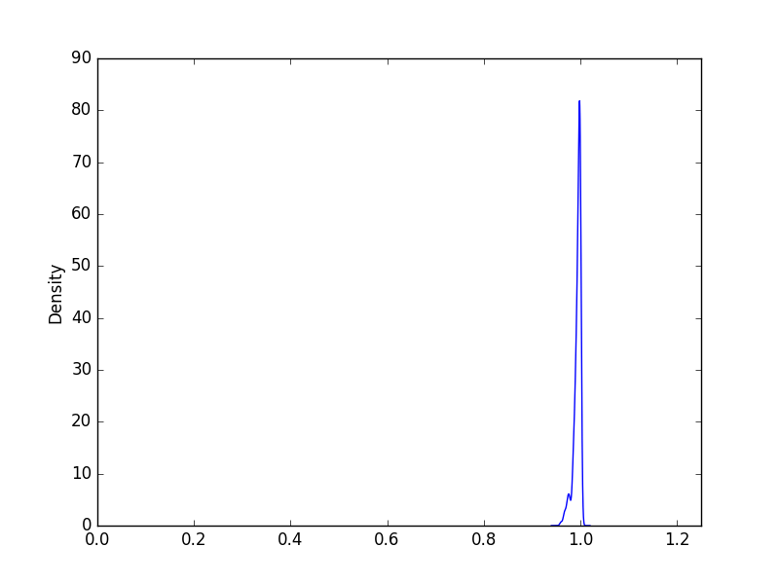
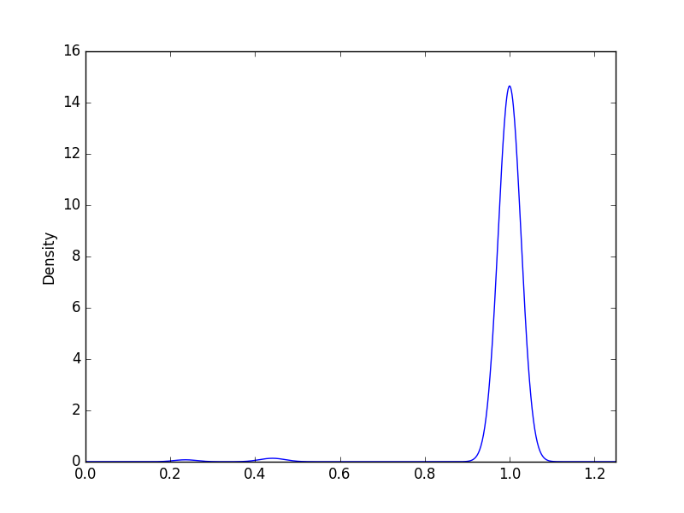
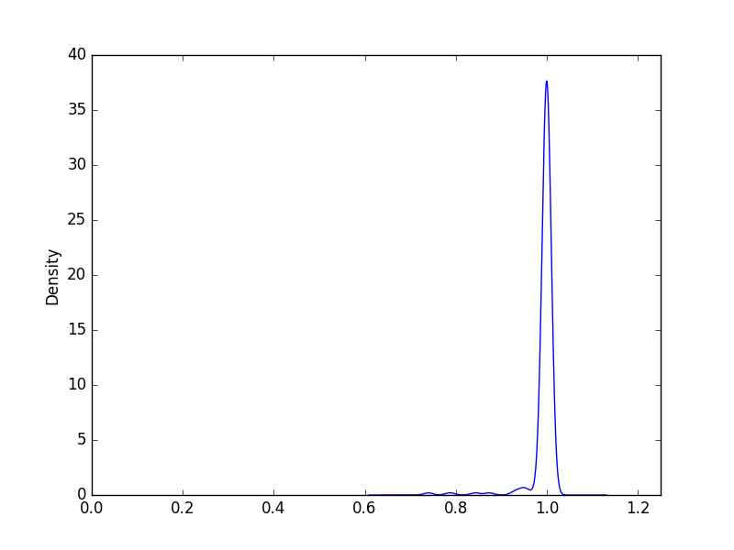
Results
supporting Strategy (1)
Isolet
Letter
Mf-zer
Mf-mor

Slide 34
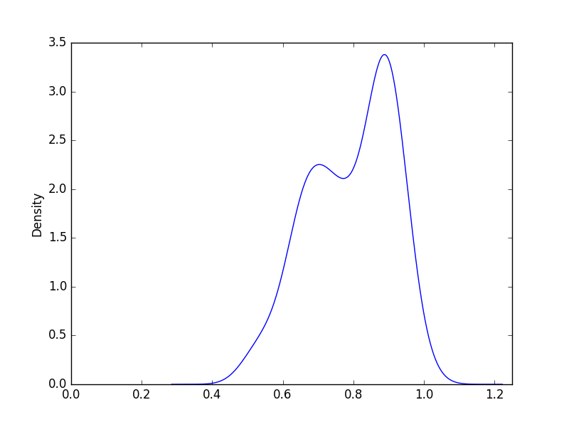
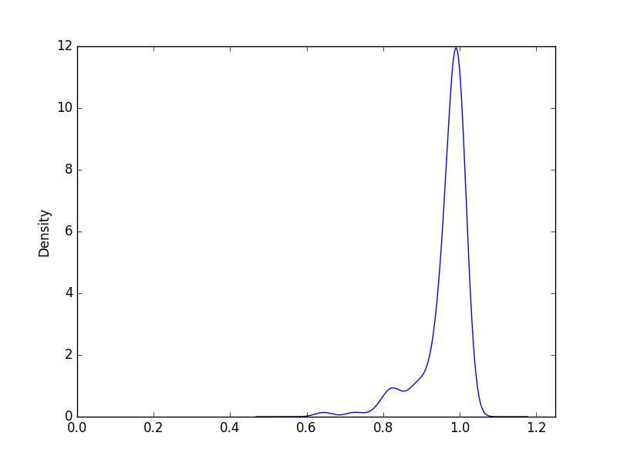
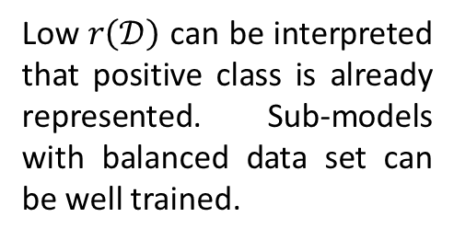
Results
supporting Strategy (3)
Low $r\left(𝒟\right)$ can be interpreted that positive class is already represented. Sub-models with balanced data set can be well trained.
Haberman
Ionosphere
Pima

Slide 35
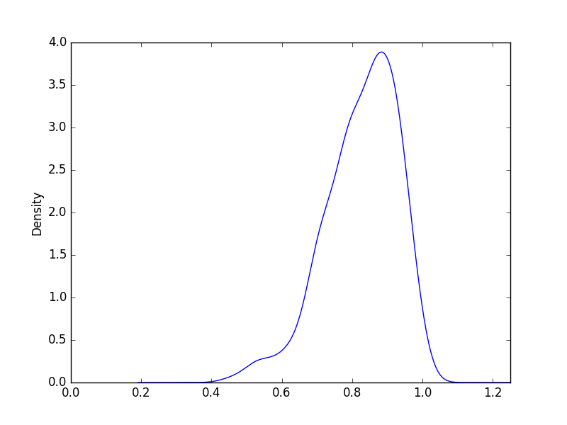
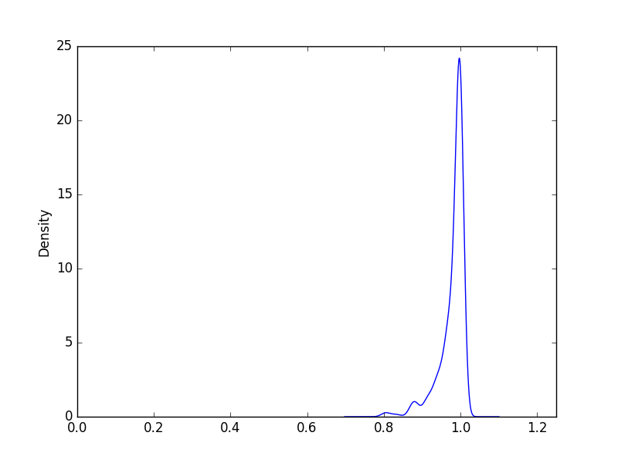
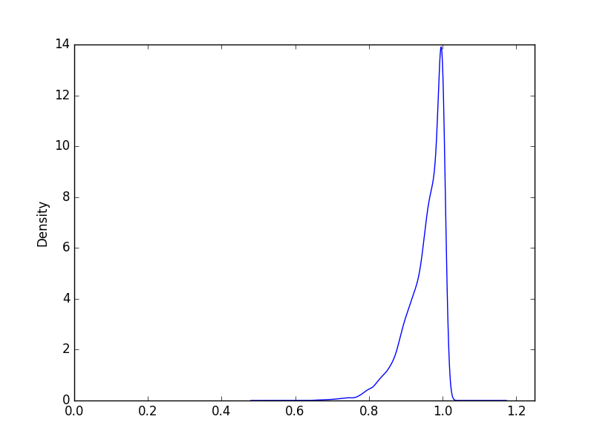
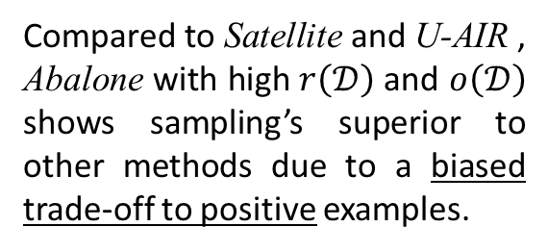
Results
supporting Strategy (2)
Compared to Satellite and U-AIR , Abalone with high $r\left(𝒟\right)$ and $o\left(𝒟\right)$ shows sampling’s superior to other methods due to a biased trade-off to positive examples.
Abalone
Satellite
U-AIR

Slide 36



Sampling on High $r\left(𝒟\right)$ and $o\left(𝒟\right)$
Before Sampling
After Sampling
TP rate: 23%
TN rate: 95%
TP rate: 81%
TN rate: 93%

Slide 37

Results
supporting Strategy (4)
Satellite-20
The comparison between Satellite and Satellite-20 infers the robustness for SVDD to tackle with the lack of positive data.

